Slide 1



From model-free to model-aware learning of quantum controls
Decision-making in quantum environments
Matías Bilkis
PhD Defense
12th June, 2023
Advisor: Prof. John Calsamiglia

Slide 2

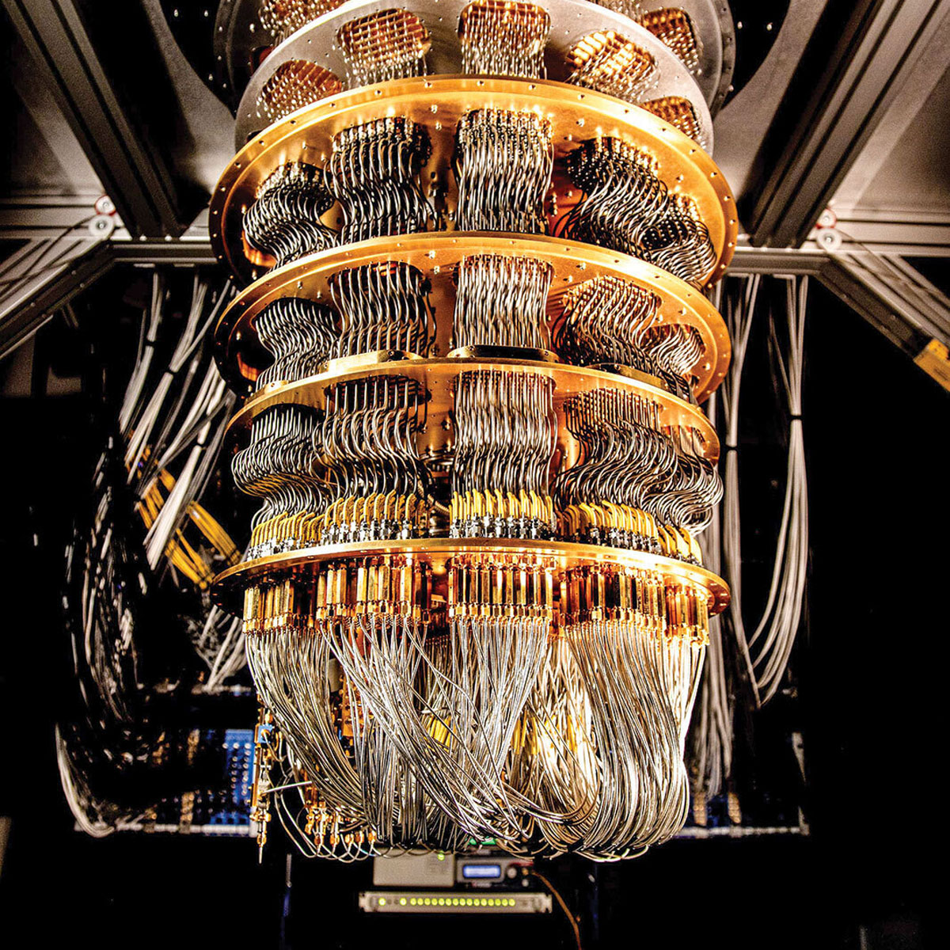
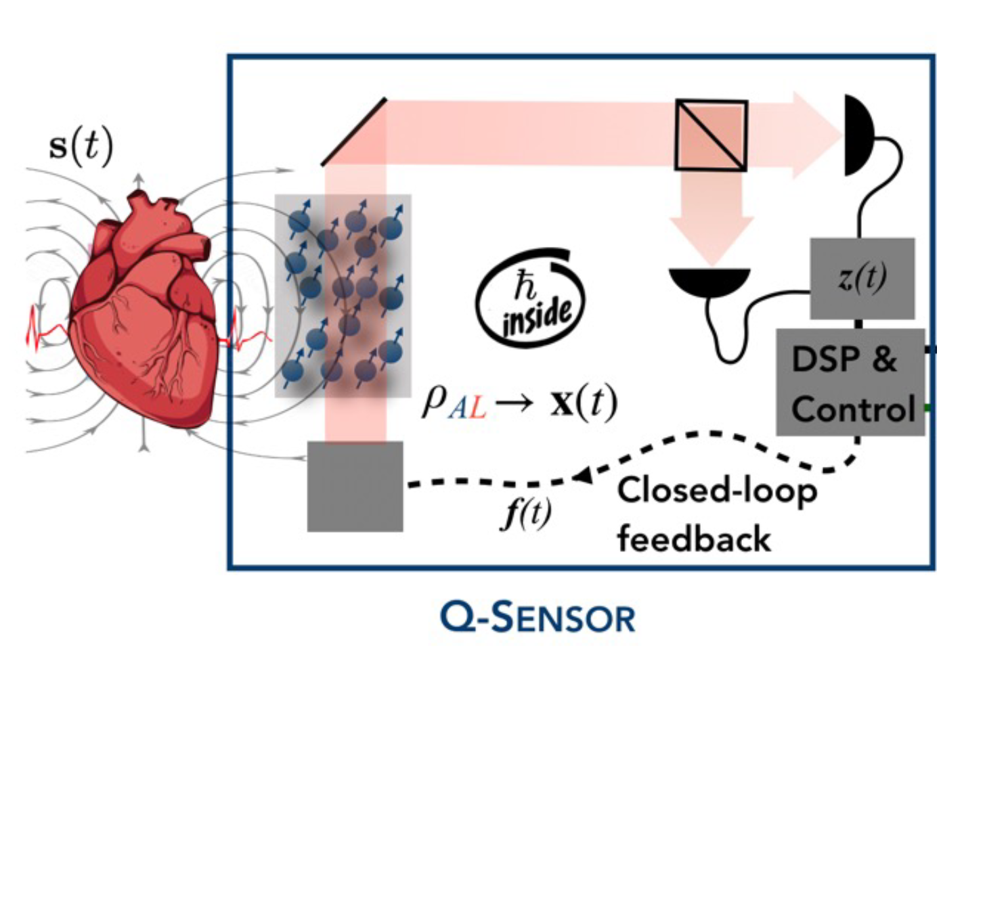
Quantum technology toolbox

Slide 3
Quantum technology toolbox

Slide 4

Decision-making

